Slide 1

Unit 10

Slide 2
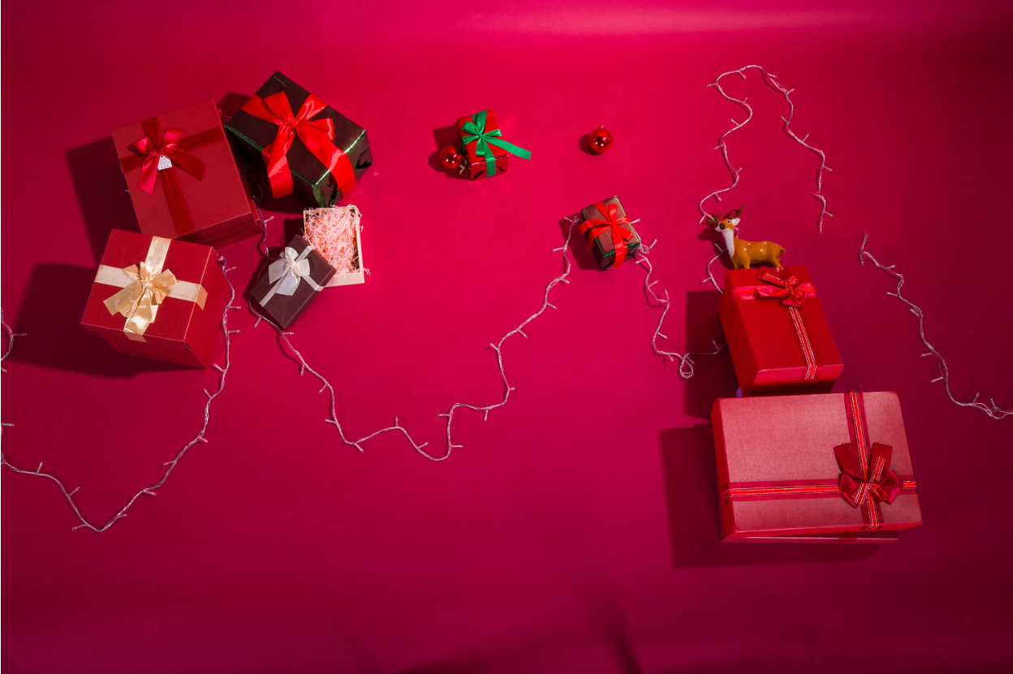
Unit 10
If you go to the party,
you’ll have a great time!

Slide 3
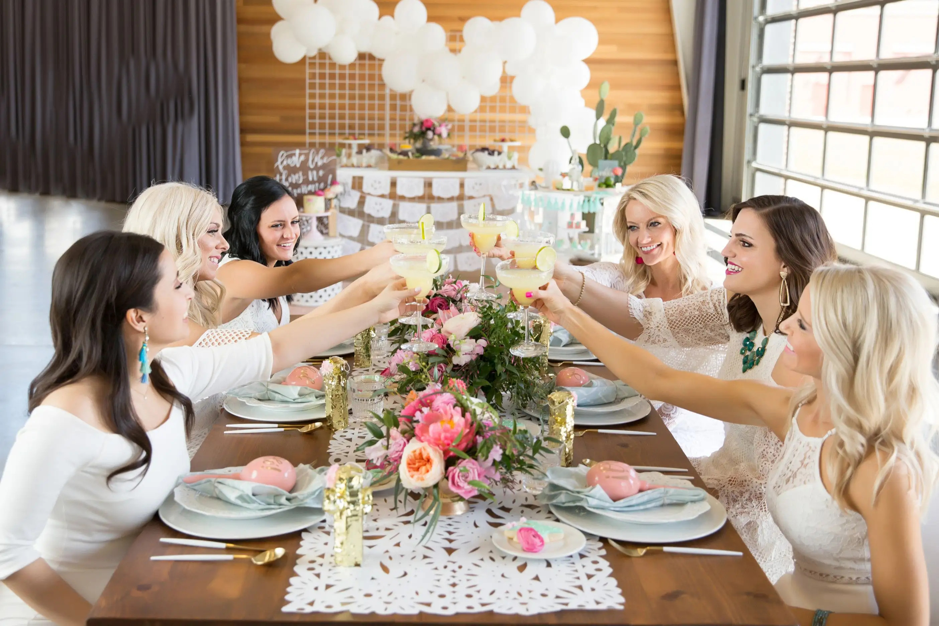


Slide 4
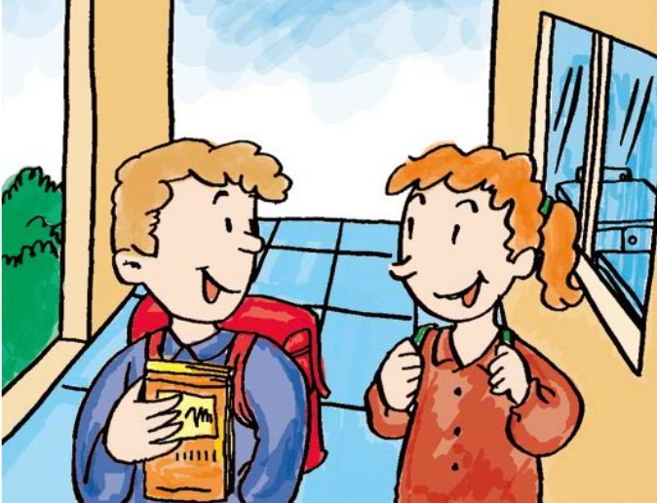
Before Reading
Ben
Jeff
Jeff wants to have a class party.
Think about what Jeff needs to prepare for the party.

Slide 5


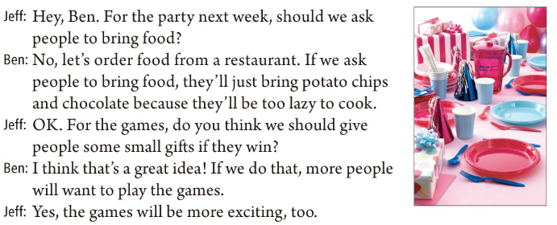
Listen to the conversation.
What does Jeff need to prepare for the party?

Slide 6
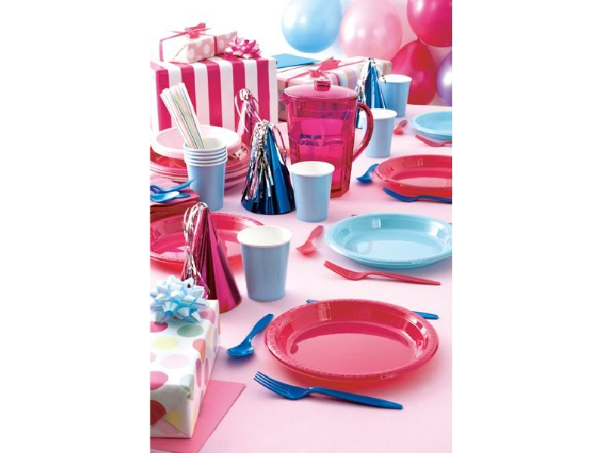
Read the conversation and answer the questions.
1. What will happen if Jeff and Ben ask people to bring food?
2. What will happen if Jeff and Ben give people some small gifts when they win the games?
People’ll just bring potato chips and chocolate
because they’ll be too lazy to cook.
More people will want to play the games and the games will be more exciting.

Slide 7
Role-play the conversation.
if 引导的条件状语从句

Slide 8

Exercise
根据课本内容及汉语提示，完成下列句子。
1. 我想我将乘公共汽车去参加聚会。
I ______ I’ll take the bus to the ______.
2. 如果你那样做，你将会迟到。
If you ______, ______ be late.
3. 我想我会待在家里。
I ______ ______ stay at home.
4. 如果你那样做，你会觉得遗憾。
If you ______, ______ ______ sorry.
think party
do you’ll
think I’ll
do you’ll be

Slide 9
5. 如果他们今天举行派对，将发生什么事？
_______ _______ _______ if they _______the party today?
6. 如果他们今天举行派对，班里一半的学生将不会去。
If they _______ it today, _______ the class _______ come.
7. 我们应当让人们带食物来吗？
Should we _______ people to _______ food?
8. 如果我们要求人们带食物来，他们将只带薯条和巧克力。
_______ we _______ people to bring food, _______ just _______ potato chips and chocolate.
What will happen have
have half
won’t
ask bring
If ask
they’ll
bring

Slide 10


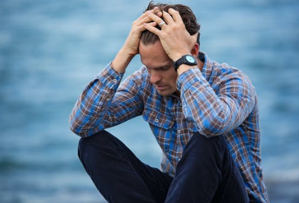
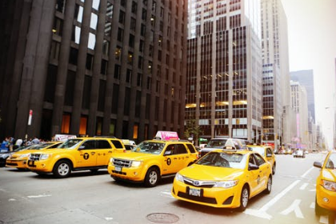
upset adj. 难过；失望；沮丧
e.g. My mom will be upset if I forget it again.
如果我再忘记，我妈妈会失望的。
taxi n. 出租车；的士
e.g. You’d better take a taxi there.
你最好(You’d better)乘坐一辆的士去那儿。

Slide 11

advice un. 劝告；建议
a piece of advice
一条建议；一个忠告
give sb advice
给某人建议
take one’s advice=follow one’s advice
听从某人的建议/劝告
e.g. Can you give me some advice?
你能给我一些建议吗？
e.g. Let me give you a piece of advice.
我来给你一个忠告。

Slide 12


Fill in the blanks with the correct forms of the verbs in brackets.
Dear Su Mei,
I don’t _______ (know) what to _______ (do) about going to Mike’s birthday party tomorrow night. My parents _______ (think) I should study for my English exam next week. If I _______ (go) to the party, they _______ (be) upset.
know
do
think
go
will be

Slide 13
Mike _________ (tell) us to wear nice clothes, but I don’t _________ (have) any. If I _________ (wear) jeans, I _________ (look) the worst. Also, I’m not sure how to _____ (go) to the party. If I _________ (walk), it _________ (take) me too long. If I _________ (take) a taxi, it _________ (be) too expensive. Can you give me some advice please?
Tina
told
have
wear
will look
go
walk
will take
take
will be

Slide 14

Complete the sentences using your own ideas.
1. If I get up late tomorrow, ____________________________
2. If I don’t finish my homework, _______________________
3. If I don’t get enough exercise, _________________________
4. I will not have enough time to study if _________________________________
5. I will not make any friends if _________________________________
I’ll be late for school.
my teachers will ask me to finish at school tomorrow.
I’ll get heavy.
I play basketball for two hours after school every day.
I am not ready to help others.

Slide 16

Read the passage and answer the questions.
Who wrote this letter?
Who is this letter for?
Why does the person write the letter?
What are some worries the person has?

Slide 17

Talk about Tina’s worries using the sentence with “if”.
to go or not to go
what to wear
how to get there
Tina’s worries:
If Tina goes to the party, her parents will …
If Tina wears jeans, I will…
If Tina walks there, it will…
If Tina takes a taxi, it will…

Slide 18
Complete the sentences using your own ideas.
1. If I get up late tomorrow, ___________________________
2. If I don’t finish my homework, ______________________
3. If I don’t get enough exercise, _______________________
4. I will not have enough time to study if ________________
5. I will not make any friends if ________________________

Slide 19



To learn the first conditional if + will:
If…, you’ll…
— What will happen if they…
— If they ..., …will/won’t…
To learn the words: upset, taxi, advice

Slide 20


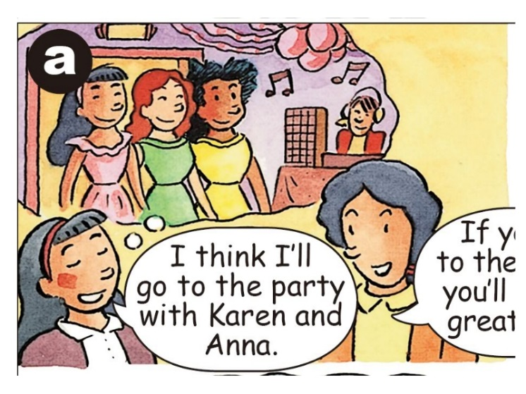
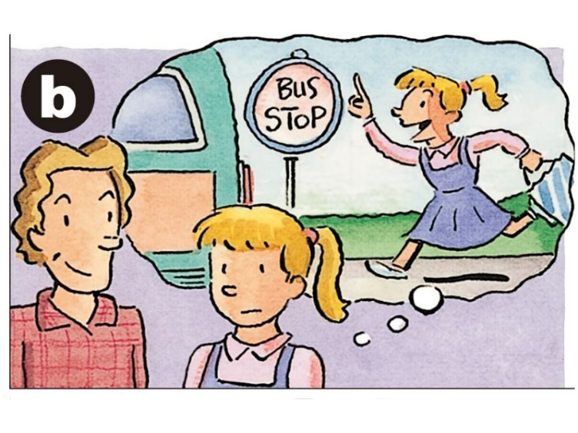
Look at the pictures and make sentences with “if”.
If you go to the party with Karen and Anna, you’ll have a good time.
If you take the bus to the party, you’ll be late.

Slide 21
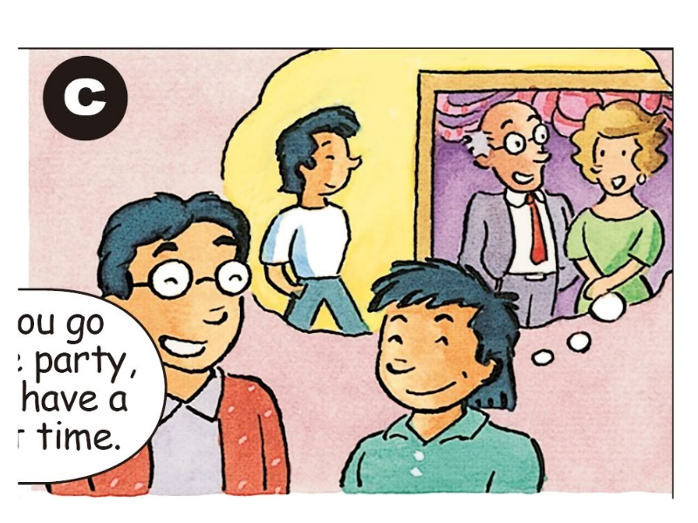
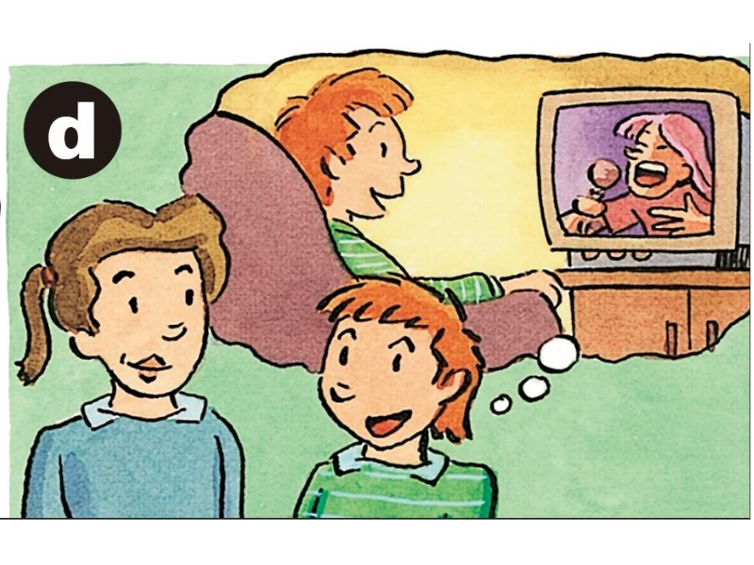
If you wear jeans to the party, the teachers won’t let you in.
If you stay at home, you will be sorry.

Slide 22


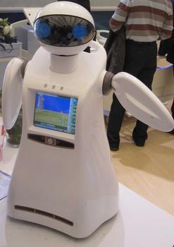
If you have a robot, what will you do?
If I have a robot, I will let it…
help with the housework.
babysit my little brother.
wake me up in the morning.
teach me English after school.

Slide 23

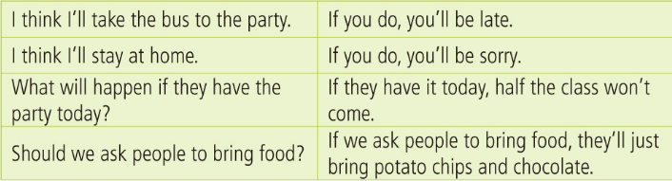
都表示对事情的结果进行预测。
Can you tell the conjunction (连词) that connects the two parts of the sentences? What does it mean?

Slide 24
What tenses do the sentences use?
一般现在时
一般将来时

Slide 25
What’s the meaning of the “do” here?
If you take the bus to the party, you’ll be late.
If you stay at home, you’ll be sorry.

Slide 26

【语境应用】完成句子。
1) Put up your hands if you ___________ (have) any questions.
2) If it ___________ (be) cold tomorrow, I will wear my sweater.
3) He can go home if he ___________ (finish) his homework.
4) 如果他来了，我们会让你知道的。
If he ___________, we ___________you know.
5) 如果天不下雨，她会开车来我家的。
If it ___________, she _________ to my home.
have
is
finishes
comes will let
doesn’t rain will drive

Slide 27
单项选择。
1) —Mrs. Li, will you be angry _______ your students don’t obey the rules in class?
—A little. But I will stop them in a friendly way.
A. if B. unless C. though
2) _______ you drive, you mustn’t drink wine at all.
A. If B. Unless C. Though
3) — Let’s go climbing Langshan Mountain this Saturday
_______ the weather is fine.
—Good idea!
A. though B. if C. unless
A
A
B

Slide 28

1. You need to practise speaking every day _______ you hope to improve your spoken English. (2021 江苏南京)
A. if B. although C. unless D. until
2. Jason will go to visit his grandparents _______ he finishes his work this weekend. (2021 贵州安顺)
A. unless B. though C. if
A
C

Slide 29


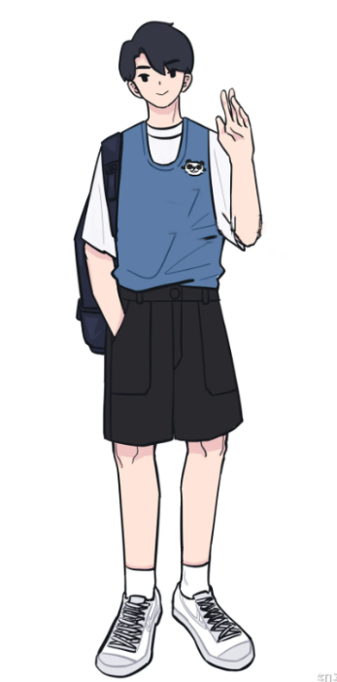
Finish the following sentences according to the example.
if will
she, call me, I, tell her about it
If she calls me, I will tell her about it.
he, come, next weekend, I, tell you
If he comes next weekend, I will tell you.

Slide 30

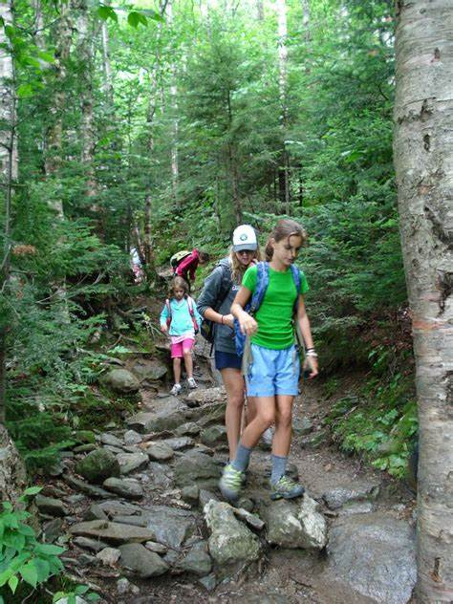
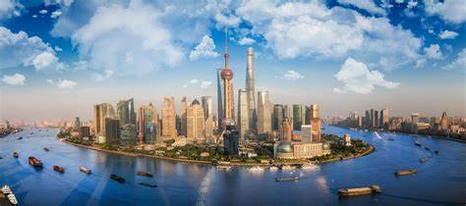
no war, the world, more beautiful
If there is no war, the world will be more beautiful.
not rain, go hiking, this afternoon
If it doesn’t rain, we will go hiking this afternoon.
he, have free time, go to Shanghai
If he has free time, he will go to Shanghai.

Slide 31

句型转换
1. They will invite me. I’ll go to the party. (用if合并为含有条件状语从句的复合句，且从句在前)
2. I’ll come back late this evening. Don’t wait for me to have dinner. (用if合并为含有条件状语从句的复合句，且从句在后)
If they invite me, I will go to the party.
Don’t wait for me to have dinner if I come back late this evening.

Slide 32




if引导的条件状语从句。
if条件句，放在前，逗号要放主句前；
if条件句，表条件，主将从现是关键。

Slide 33


Ⅰ. 根据句意及括号内所给词语的提示填空。
1. We ____________ (go) to the beach if it ____________ (not rain) this afternoon.
2. If Maria ____________ (get) good exam results, she ____________ (travel) to Hong Kong next year.
3. ____________(call) me if you ____________ (have) any problems.
will go doesn’t rain
gets
will travel
Call have

Slide 34
4. They ____________ (not come) to my party if their parents ____________ (not let) them.
5. What ____________ you ____________(do) if they ____________(ask) for your help?
6. If you ____________ (not leave) now, I ____________(call) the police.
will not come
don’t let
will do
ask
don’t leave will call

Slide 35
Ⅱ. 根据短文内容及括号内所给英文提示语补全短文。
When your parents have to leave you alone (单独) at home, what will you do to be safe (安全的)? Of course, your parents are always telling you a lot of things to stay away from danger.
Don’t be bored, just listen to them. (1)_______________________________________________ (if, follow ... advice, stay away from danger). OK. Let’s see what advice your parents used to give you.
Lock the door (锁门). (2)______________________________________________________________ (if, forget, lock, after, get home, dangerous). If a stranger comes to your door, it’s best to ignore (不理会) it.
If you follow their advice, you’ll stay away from danger
If you forget to lock the door after you get home, it will be dangerous

Slide 36
Don’t invite a person that you don’t know well to your house. (3)___________________________________ (if, do that, be in danger). What’s more, be careful about answering new phone calls. (4)_______________________________________________ (if, number, new to you, not pick up). Make sure you can use household appliances (家用电器). (5)_______________________________________________ (if, can’t, use ... in the right way, not use).
Never tell anyone that your parents are not at home. If you need any help, call 110 or your parents right away.
If you do that, you’ll be in danger
If the number is new to you, don’t pick it up
If you can’t use them in the right way, don’t use them

Slide 37


Write a story with your group on a piece of paper. The first person begins the story with “I think I will…” The others add some sentences with “if”. Pass the paper around twice. Then read the story.
I think I will go to the movies tonight. If I go to the movies, I won’t finish my homework. If I don’t finish my homework…

Slide 38

If I don’t finish my homework, I won’t do well in my test.
If I don’t do well in my test, my parents will be upset.
…

Slide 39
